Slide 1

Extending AF_XDP for fast co-located packet transfer
Debojeet Das, Kevin Prafull Baua, Aditya Kansara, Arghyadip Chakraborty, Dheeraj Kurukunda, Mythili Vutukuru, and Purushottam Kulkarni debojeetdas@cse.iitb.ac.in Systems and Networking Research Group (SynerG) Department of Computer Science and Engineering Indian Institute of Technology Bombay
FOSDEM^{’26} JAN 31, 2026

Slide 2
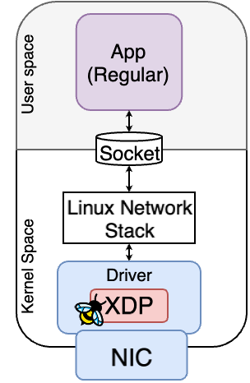
Fast network I/O with XDP and AF_XDP
XDP and AF_XDP allows us to deploy our-own high-performance load balancer, firewall, etc.
eBPF/XDP
In-kernel packet processing
- eBPF based
- eBPF restricted constraints
if (pkt.ip == a.b.x.x)
DROP

Slide 3
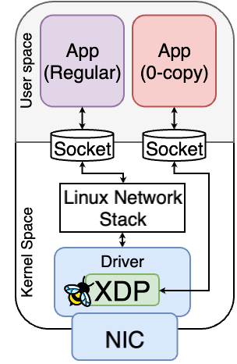
Fast network I/O with XDP and AF_XDP
XDP and AF_XDP allows us to deploy our-own high-performance load balancer, firewall, etc.
eBPF/XDP
In-kernel packet processing
- eBPF based
- eBPF restricted constraints
AF_XDP
Partial kernel bypass via XDP - zero-copy delivery to user apps
- Interrupt driven/Busy poll
if (pkt.ip == a.b.x.x)
DROP
if (pkt.ip == a.b.x.x)
Redirect to AF_XDP sock 1

Slide 4
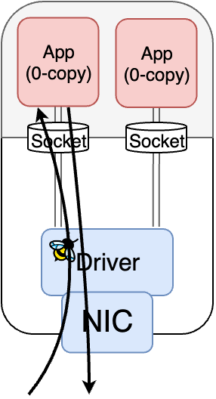
Co-locating multiple AF_XDP zero-copy apps
NIC
Firewall
Load Balancer
Router
Goal: Efficient co-location of AF_XDP zero-copy apps to provide complex services Problem: AF_XDP lacks socket-to-socket redirection much less zero-copy transfers
X

Slide 5
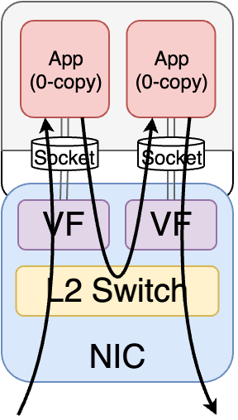
Existing solutions for co-located packet transfers between AF_XDP sockets
SR-IOV
Pros: No API modifications needed Cons: Limited AF_XDP support - VF support only in mlx5 - SF support only in ice and mlx5 Performance hit from app-to-app copying

Slide 6
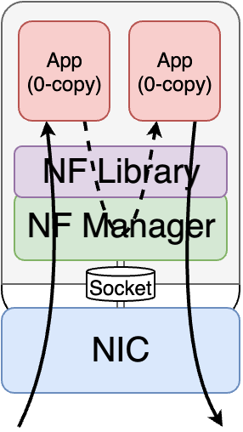
Existing solutions for co-located packet transfers between AF_XDP sockets
SR-IOV Userspace Chaining*
Pros: No API modifications needed Cons: Limited AF_XDP support - VF support only in mlx5 - SF support only in ice and mlx5 Performance hit from app-to-app copying
Motivated from existing DPDK solutions like OpenNetVM, etc. Pros: Zero-copy packet transfers Cons: Requires new APIs Creates tight coupling between Apps and libraries
*Possible Solution

Slide 7
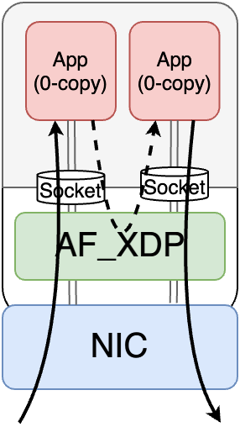
Our work: In-kernel packet transfers for AF_XDP
Flexible co-location via AF_XDP kernel extensions
Zero-copy for shared memory sockets; single-copy for others
Backward compatible solution: Transparent redirection with zero changes to userspace APIs
FLASH: Fast Linked AF_XDP Sockets for High-Performance Chaining

Slide 8
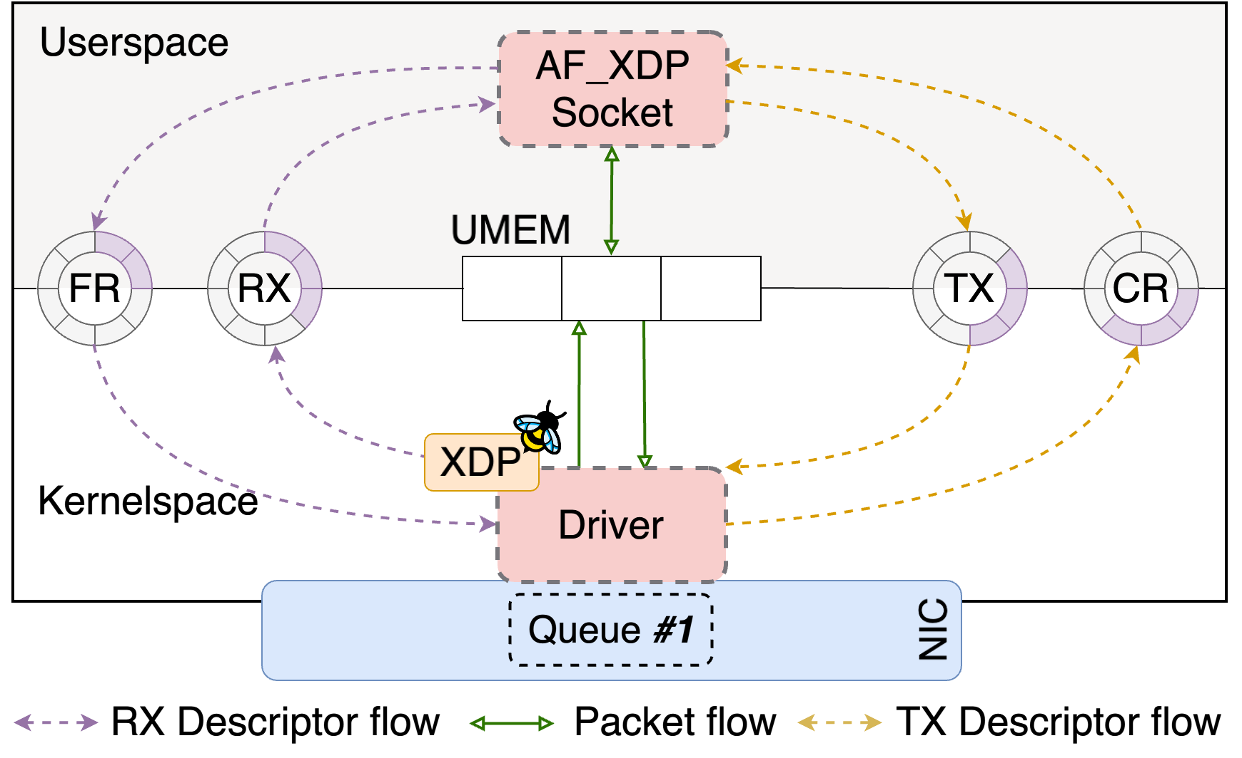
Split data path of AF_XDP
Driver handles RX/TX
UMEM (buffer pool) shared between userspace application and kernel
SPSC rings to maintain packet accesses
Fill Ring and Rx Ring used in packet reception
Tx Ring and Completion Ring used in packet transmission

Slide 9
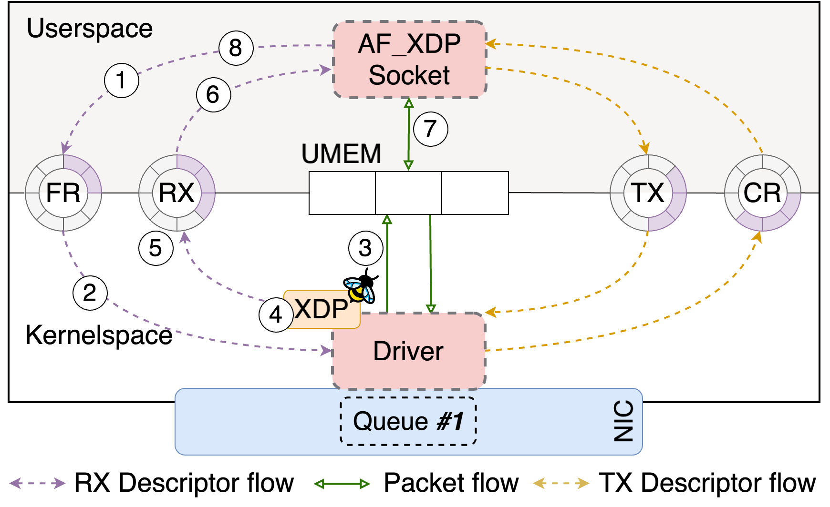
Packet Reception in AF_XDP
Applications provide free descriptors for DMA
Kernel allocates them to NIC
NIC DMA’s the packet to UMEM
napi_poll executes the XDP program which returns the socket where the packet should be sent
The Driver calls AF_XDP subsystem’s function to place the descriptor in Rx ring
Application reads 7. processes and 8. recycles descriptors.

Slide 10

Packet transmission and modes of AF_XDP
8b. to 12. shows the transmission path which uses the Tx and completion rings
The kernel space operations are initiated by the driver with the help of AF_XDP subsystem functions*
Driver can either invoke them based on interrupts or via hints using sendto() and recvfrom() syscalls (Busypoll)
*The functions can be found at include/net/xdp_sock_drv.h

Slide 11
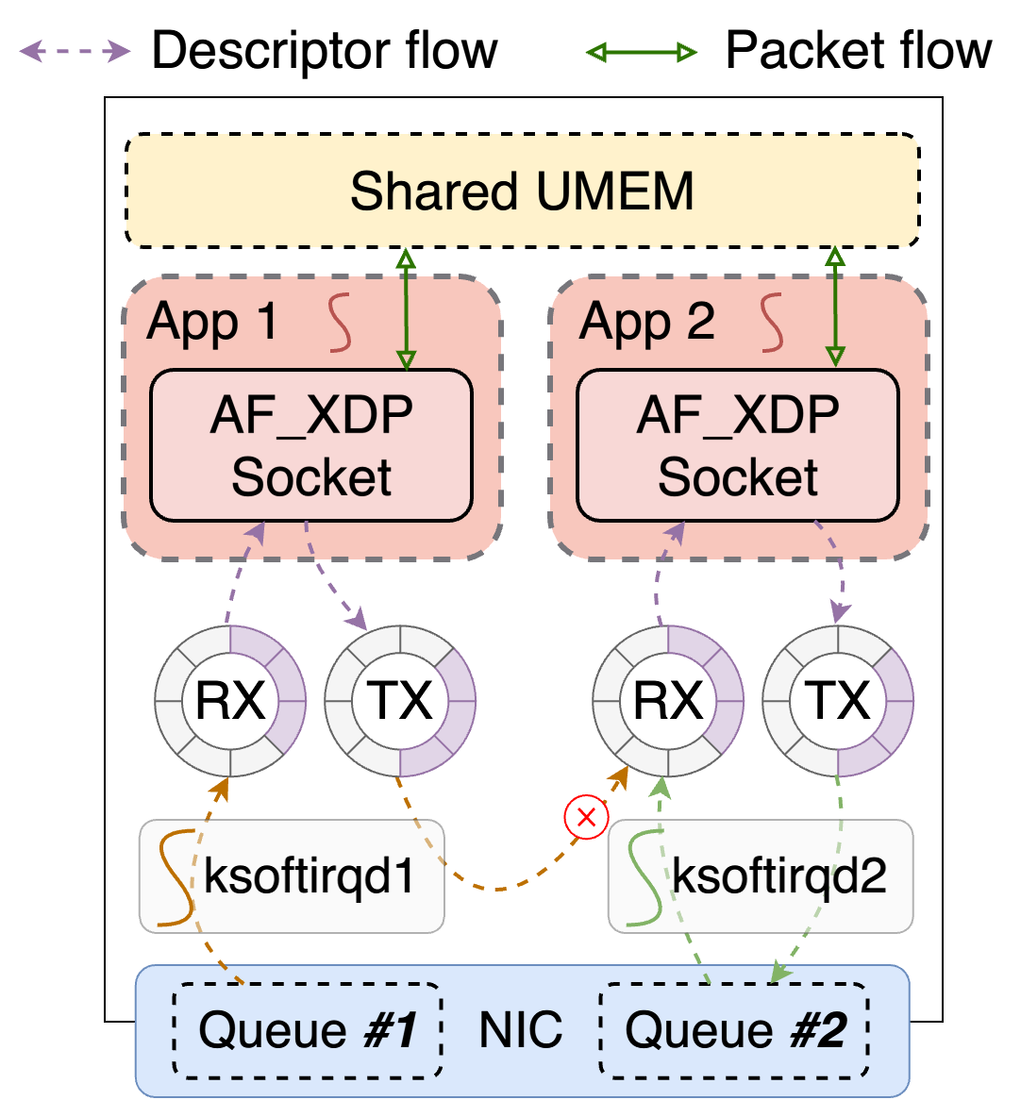
Challenge #1 Ring semantics
Redirection violates SPSC (Single-Producer/Single-Consumer) semantics
Key Idea #1: Backward-compatible MP/MC lockless rings
CAS operations serialize MP/MC while maintaining SP/SC for userspace
struct xdp_ring {
u32 producer; // Old field; represents producer_tail
u32 consumer; // Old field; represents consumer_tail
u32 flags;
u32 producer_head; // Used only for MPSC
u32 consumer_head; // Used only for SPMC
};
int xskq_enqueue_desc(struct xsk_queue *q, u64 addr, u32 len, u32 flags);
bool xskq_dequeue_desc(struct xsk_queue *q, struct xdp_desc* desc, struct xsk_buff_pool *pool);

Slide 12
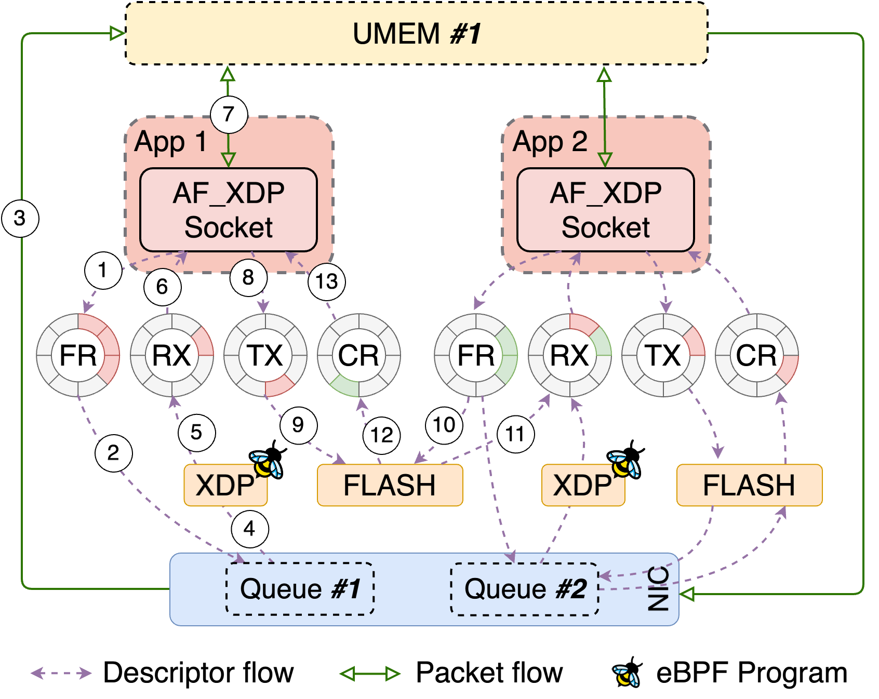
Zero-copy redirection with MP / MC rings
Packet data stays in shared UMEM
FLASH can move packet descriptor from TX ring of App 1 to RX ring of App 2
FLASH brings back empty descriptor from fill ring of App 2 to completion ring of App 1
Fill ring becomes MC in kernel and Rx ring becomes MC in kernel
single-copy redirection works similarily but using memcpy

Slide 13
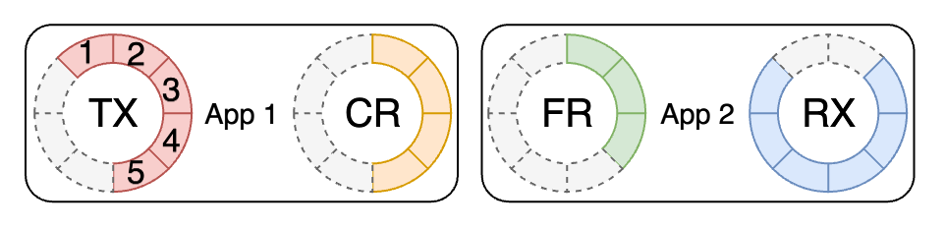
Challenge #2: Batched redirections
We, batch redirections to amortize CAS overhead
u32 xskq_bulk_enqueue_descs(struct xsk_queue *q, struct xdp_desc* descs, u32 n_descs);
With new MPSC/SPMC rings, available capacity changes mid-redirection
FR descriptors cannot be returned without violating ring semantics
Key Idea #2: Partial TX + Descriptor Buffering
Order ring updates so any packet placed in TX is guaranteed to redirect
Buffer extra FR descriptors for use in the next iteration

Slide 14
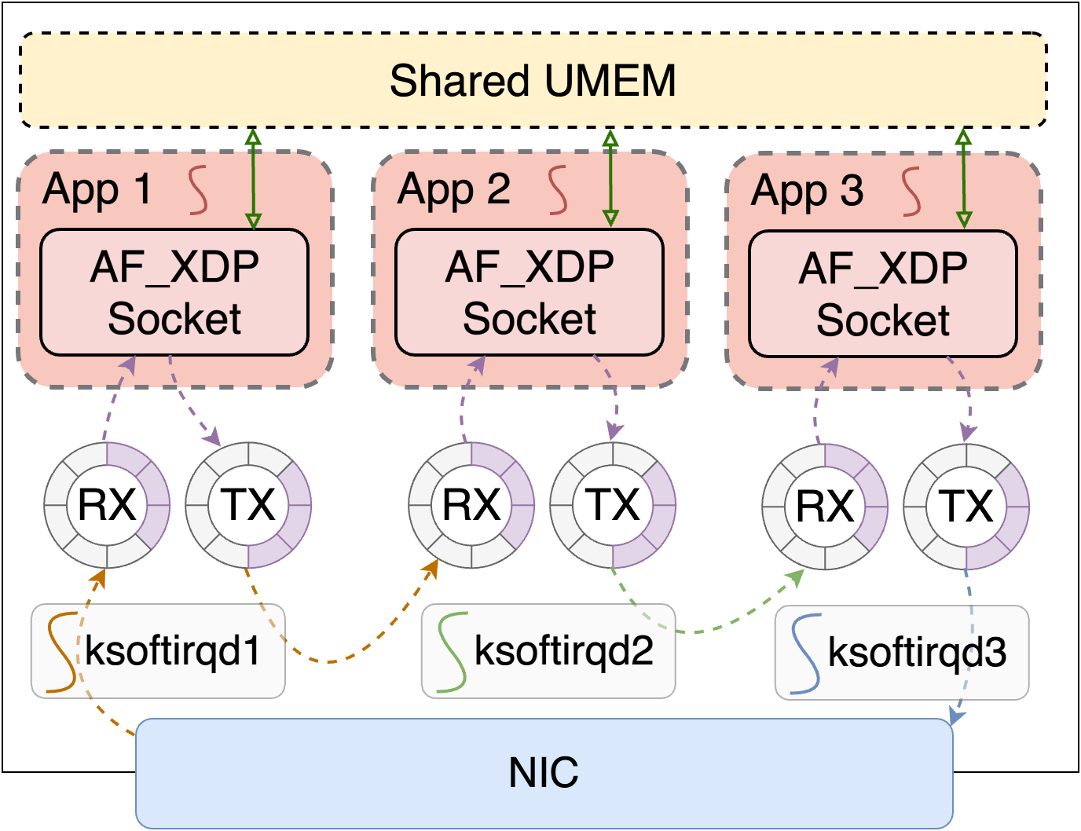
Challenge #3: Scheduling threads
To balance CPU utilization and performance a hybrid polling workflow is usually employed in applications:
Start in interrupt mode: Use poll() with the POLLIN flag to block until packets arrive
Switch to busy-polling: At high rates, switch to a busy loop using recvfrom() to continuously process packets
Revert to interrupt mode: When load decreases, return to interrupt mode
By default, hybrid polling across packet transfers doesn’t work
Moreover, during congestion, the sender must retry transmissions until space becomes available this leads to wastage of CPU cycles

Slide 15
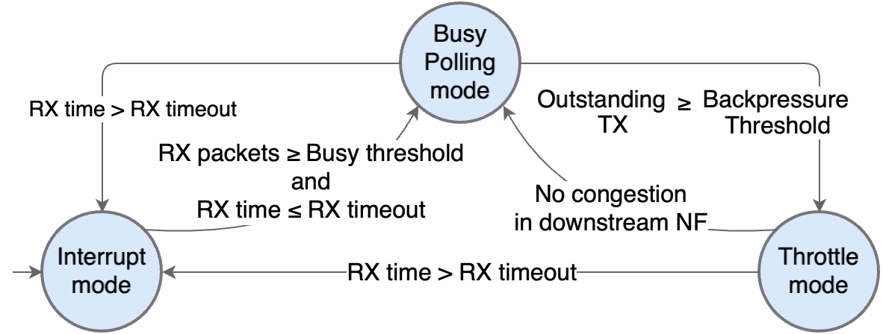
Smart polling and early backpressure detection
Key Idea #3: Smart Polling & Early Backpressure
Extends hybrid polling across redirection paths
Congestion Handling: Senders block via poll() (POLLOUT) until space
Wake-up Signal: Receivers use recvfrom() (MSG_MORE) to signal senders

Slide 16
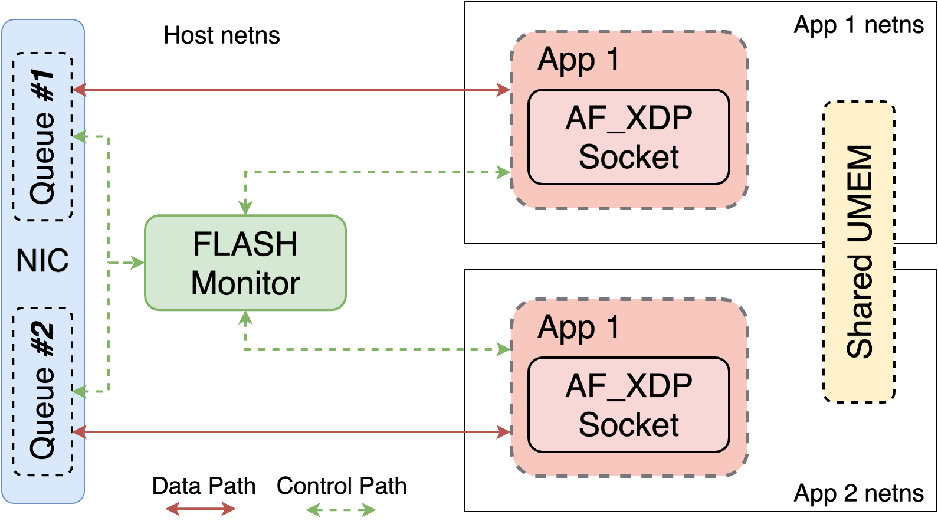
Challenge #4: Performance vs. safety
How to isolate zero-copy Apps from each other in multi-tenant settings?
Key Idea #4: FLASH monitor and safe runtime
FLASH Monitor: Offloads privileged tasks and manages access control
Rust Runtime: Ensures memory and packet isolation in multi-tenant setups

Slide 17
But how do you specify the path of transfers?
We need a way to inspect active AF_XDP sockets and configure transfer rules between sockets
FLASH should then use the rules to access the rings and perform the transfers
But, the sockets (struct xdp_sock) and its rings are backed by process local fds
How do XDP get access of rings then?
It stores the struct xdp_sock in a map and uses XDP program to select the socket on packet reception
Our Solution: Expose a sysfs interface under /sys/kernel/flash to store the sockets and configure redirection rules*
For example, if there are two sockets and we want all packets from socket 1 to go to socket 2 # echo 2 | sudo tee /sys/kernel/flash/1/next
*We also support dynamic packet transfers

Slide 18
How much change is needed to support all this?
~700 LoC in AF_XDP subsystem
The changes mostly augments new features to the AF_XDP subsystem
Requires straightforward patching in driver to ignore packet transmissions
bool xmit_batch(struct xsk_buff_pool *pool, unsigned int budget)
{
struct xdp_desc *descs = pool->tx_descs;
unsigned int nb_pkts = 0;
// Fetch a batch of descriptors for transmission
nb_pkts = xsk_tx_peek_release_desc_batch(pool, budget);
if (!nb_pkts)
return true;
// If redirection is configured, skip NIC transmission
if (pool->no_tx_out) // New lines
return nb_pkts < budget; // New lines
// Proceed with normal transmission
return nb_pkts < budget;
}
We have already added support for ixgbe, i40e, ice and mlx5

Slide 19
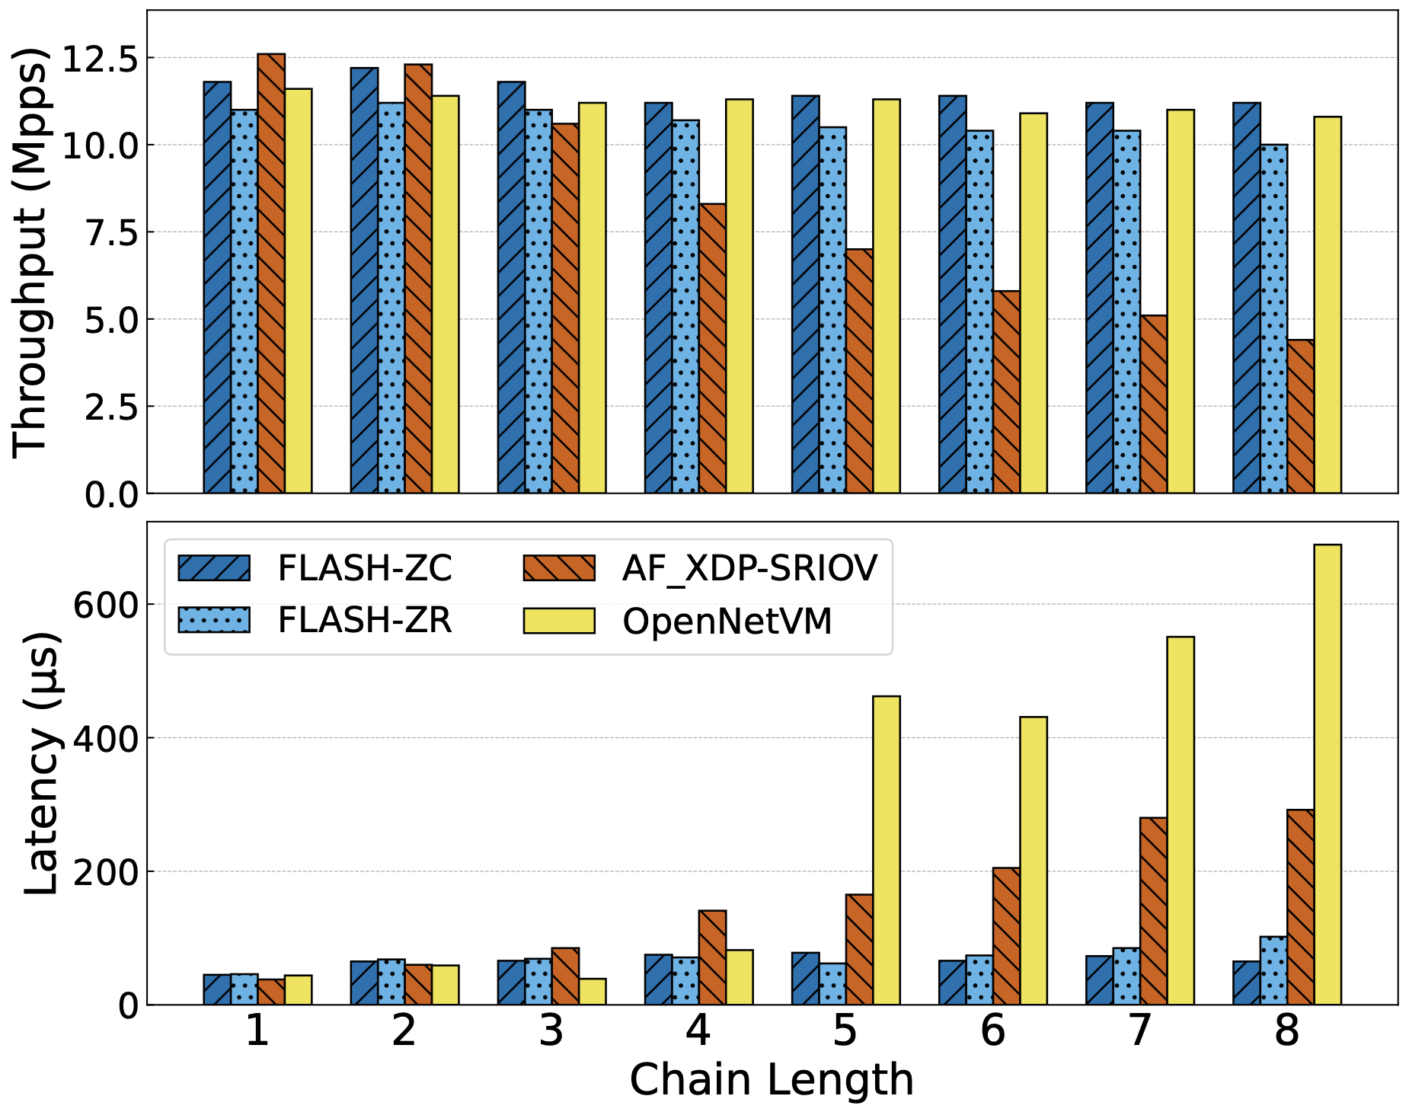
FLASH performance gains
Baselines:
AF_XDP-SRIOV: AF_XDP over SR-IOV
OpenNetVM: DPDK userspace chaining Our work:
FLASH-ZC: FLASH C library zero-copy
FLASH-ZR: FLASH Rust library zero-copy
FLASH provides lowest latency among all solutions.
FLASH-ZC provides 1.1 x - 2.5 x higher throughput than SR-IOV
24-core Intel Xeon Gold 5418Y, 128 GB RAM, HT disabled - Mellanox Connect X-4 MT27700 40Gbps (mlx5) Ubuntu 22.04 LTS, Linux Kernel 6.10.6 – Chains of L2FWD switches – Used Pktgen for load generation

Slide 20
Summary
The Problem: AF_XDP lacks native support for zero-copy packet redirection between co-located sockets
The Solution: FLASH extends the AF_XDP kernel subsystem to enable high-performance, transparent chaining
Key Ideas:
MP/MC Lockless Rings
Batching & Buffering
Smart Polling
A sysfs interface for setting up the redirections

Slide 21
Future Directions
From sysfs to XDP_EGRESS: Replace current sysfs-based rule configuration with a native XDP hook at the egress point
packet-steering logic can be entirely programmable via eBPF
Interesting use case of XDP_EGRESS? (LPC 2025)
Generalizing the service chaining framework to support diverse set of applications
mTCP Integration: Currently developing zero-copy support for TCP-based applications
Using SPMC/MPSC rings of AF_XDP for other use-cases:
Packet redirection from one queue to another queue during ingress
We are also working on a Rust rewrite of FLASH monitor

Slide 22

Thank You
debojeetdas@cse.iitb.ac.in
Project Link:

